Slide 1
Web Client & Server Development
CSS and Bootstrap

Slide 2
Recap Last Week
Intro to HTML
HTML defines what the different parts of a page mean – paragraphs, links, images, emphasized text, table cells, list elements…
Intro to CSS
CSS is for specifying what these elements look like – color, background, position, border, padding, font, size, layout…
Two different technologies separate the content and the presentation
Makes it easier to change one without affecting the other; also makes re-use easier
For example, apply the same CSS stylesheet to multiple pages
Allows for designers, back end developers, content creators to work more independently

Slide 3
This Week
More HTML, CSS
Bootstrap
Pre-packaged styles, and useful components
Responsive design: enables websites to adjust layout for different screen sizes e.g. on desktop and mobile devices
Fonts
Colors

Slide 4
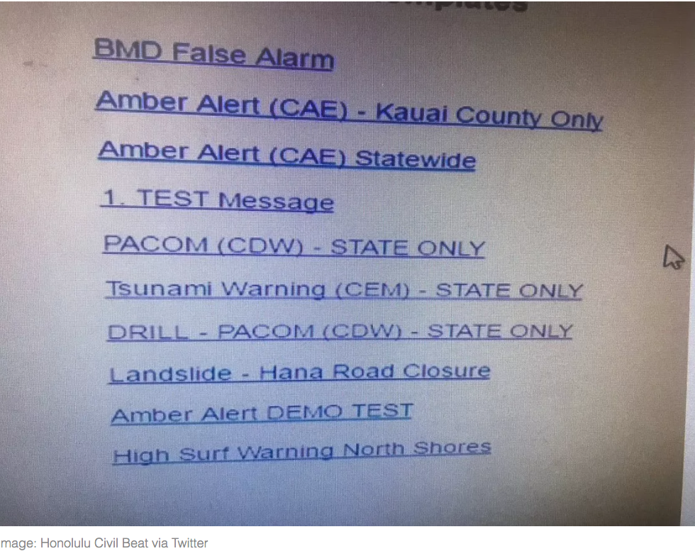
Warmup
Recall the accidental missile alert sent to residents of Hawaii in January 2018
Which option is the
alert test, and which
is the real alert??
https://en.wikipedia.org/wiki/2018_Hawaii_false_missile_alert

Slide 5
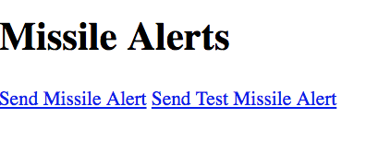
Let's make a better version
Start with this page https://git.io/fj5eE
Use CSS to style the id="test-only"
and id="real-alert" elements so they
look different
For example, use some or all of color, background-color, height, width, margin, border, padding, font-size… attributes
display: block style makes an inline element display as a block element
block = stacked vertically
inline = one after the other, on the same line
Show your page to your neighbors. Can they easily tell which one is which?
Ask your neighbor if they can suggest any improvements?

Slide 6
Example Code
At GitHub
Code for this week's examples, and live versions, at
https://github.com/claraj/week2-examples

Slide 7
HTML: Forms and Input
Several types of user input elements
input elements, various types - text, radio buttons, checkboxes, dates, color, email, file upload...
select, option elements, dropdown menus
textarea elements for multi-line input
button elements - for submitting a form
Form elements are for collecting 1 or more inputs into a group, often for submitting all of the information in the form to a server

Slide 8
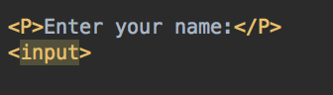
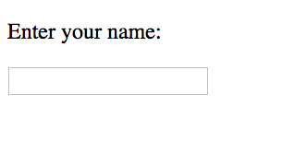
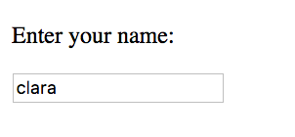
Start a new HTML page
Create an input element
Open the page in your browser, you can type in the input box

Slide 9
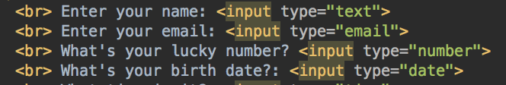
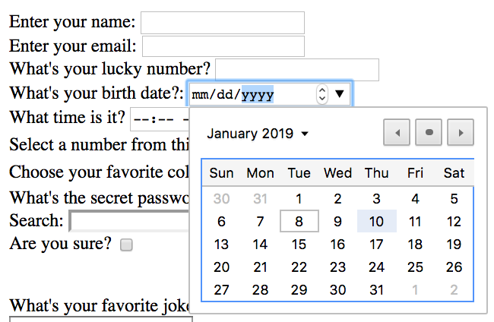
Forms and input
Various types of input elements, configured by setting the type attribute, for example
The types are hints to your browser for how to display the input element, and what type of data to accept
Most browsers show a date picker for date inputs
Will try and prevent non-numerical input for a number input

Slide 10
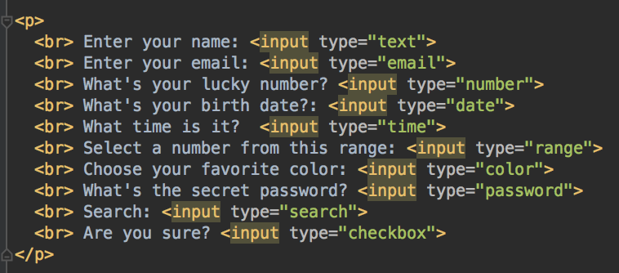
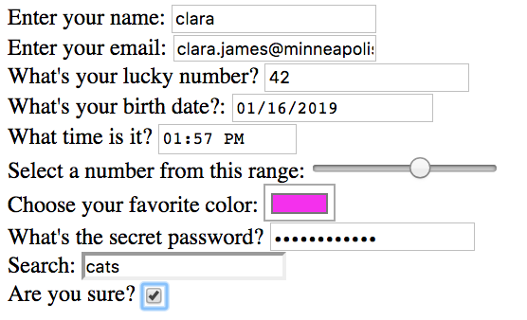
Input types
If no type is specified, the default is a single-line text box

Slide 11
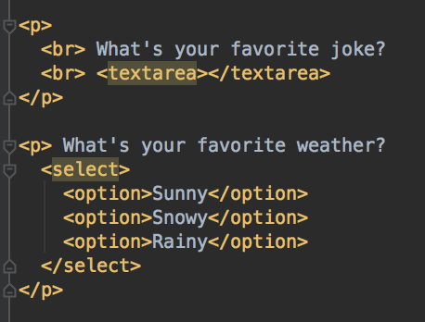
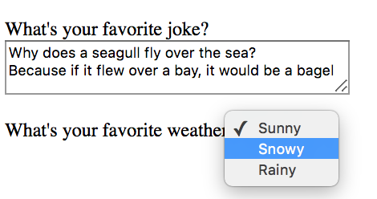
Multi-line text input, dropdowns
textarea for multi-line input
Any text between the textarea elements will be the initial text in the textarea
For dropdown inputs, group option elements inside a select element

Slide 12
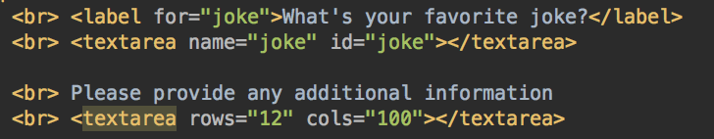
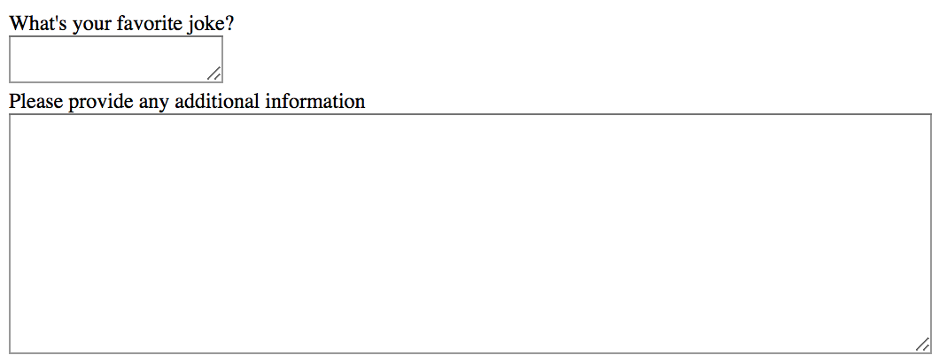
textarea
User can re-size textarea
Use rows and cols attributes to configure initial size of textarea

Slide 13
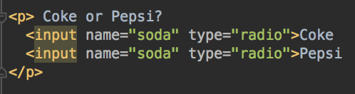
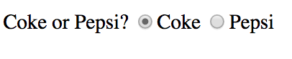
Radio Buttons
Notice the name attribute
All radio buttons with the same name attribute are part of the same button group
So, when the user selects one button in a group, the others are deselected

Slide 14
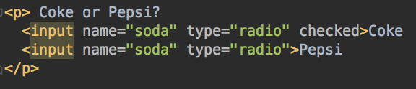
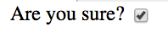
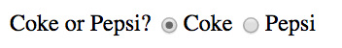
Input Values
value Every input element has a value - the data that is entered into the input. The value is updated behind the scenes as the user enters data
Use the value attribute to set a initial value or default
Exception: for checkboxes and radio buttons, set the checked attribute. It's a Boolean attribute so you just need to include checked

Slide 15
Input Names, Values
name
The name attribute is used to label data values when a form is submitted to a server
When form data is submitted to a server, it is sent as name: value pairs
So, if this was part of a form, and the user types "6" into this input and submitted the form, the server would receive a message including lucky_number": 6

Slide 16
Labels
Put the text for an input in a label element and associate it with that input (or textarea or select element)
Visually, a label looks the same as in a span, but
When the user clicks on the label, the input element is selected. This makes it easier for the user to navigate your form, particularly for small inputs like checkboxes and radio buttons
Helps assistive technology e.g. screen readers, narrate and navigate the page more accurately

Slide 17
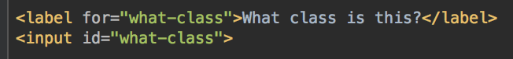
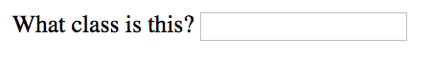
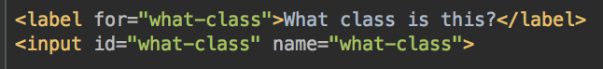
Associating Labels with Inputs
Give the input element an id
Give the label a for attribute, with same value as the input's id
Same process for textarea and select elements
And also give the input elements a name attribute
It can be the same or different to the id

Slide 18
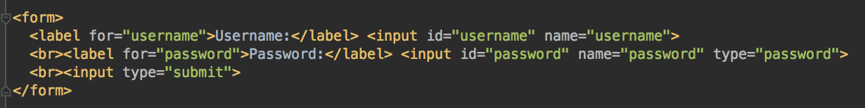
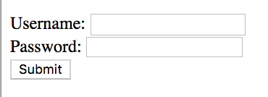
Input Elements in a Form
A form is used to submit data to a server
An input type=submit is a button, when clicked, the form is submitted
What data is submitted? name: value pairs of the input, text area, select elements inside the form
Where is the form submitted to? We'll come back to this once we start thinking about JavaScript, Vue.js and servers
input type="submit" is a button ->

Slide 19
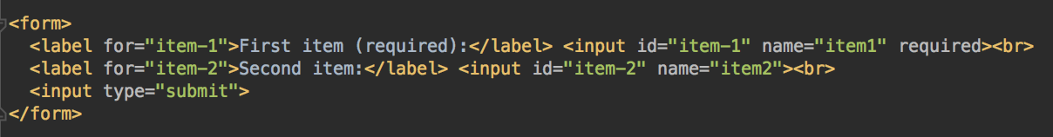
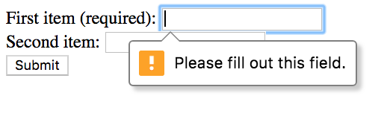
Validating and Submitting Forms
Browser can do some basic validation - for example, only allowing numbers in number inputs
When inputs are grouped in a form, the browser can check if an input has a value before the form is submitted
Add required attribute
In this example, item 1 is required. The browser will show an error message if it doesn't have a value when the submit button is clicked

Slide 20
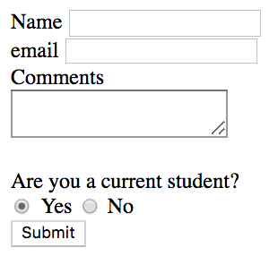
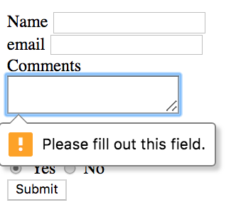
Your Turn
Imagine you are building a student feedback site
Create a form containing five inputs
A text input for a student's name
An email input for the student's email
A textarea for comments (required)
Radio buttons for are you a current student? The choices should be Yes and No.
Yes should be selected when the page loads
A submit button
Give each input an id attribute, and a name attribute with a sensible value
Use labels for each of your inputs
Make sure the radio buttons toggle correctly
Make sure you see an error message when the form is submitted, if the textarea is empty
The other inputs are optional

Slide 21
CSS
Everything you know about CSS can be applies to forms
If you enjoy design, write your own CSS
If your focus is code, and you just want things to look good quickly, then you can use someone else's CSS
CSS themes and frameworks: alternative to writing your own CSS (actually, alternative to writing all of your own CSS, you'll usually need to tweak/customize, but the framework will help)

Slide 22
CSS Frameworks and Themes
Pre-packaged CSS styles
Helpful for quickly styling an entire site
Forms look especially dated without CSS and are time-consuming to style; a framework can save a lot of time and result in consistent form styles across your site
Can be customized with your own styles
May have extra components - for example, tabs, galleries
Some type of grid layout system
Responsive design - automatically re-organize elements for different screen sizes

Slide 23
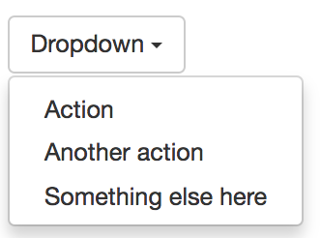
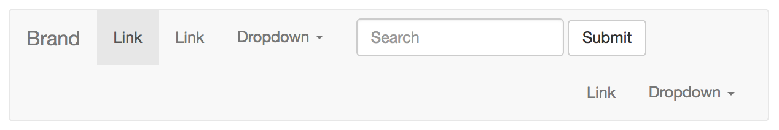
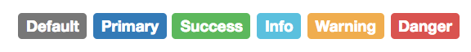
Bootstrap
Pre-built CSS/JavaScript components to create consistently-styled elements; more elements than native HTML provides, for example; tabs, dropdown menus… http://getbootstrap.com/components/
Responsive Design: can design site in a grid of rows and columns. On a large screen, columns are displayed in a row. On a smaller screen, columns start stacking within their rows. Layout is changed dynamically as screen size changed

Slide 24
Other CSS Frameworks
Bootstrap is not the only CSS framework, many others that do much of the same thing
Materialize https://materializecss.com
Bulma https://bulma.io/
Foundation https://foundation.zurb.com/
And various others

Slide 25
Let's add Bootstrap to your Student Feedback form
Need to tell the page to download and apply Bootstrap styles
Need to modify elements so the desired Bootstrap styles are applied

Slide 26
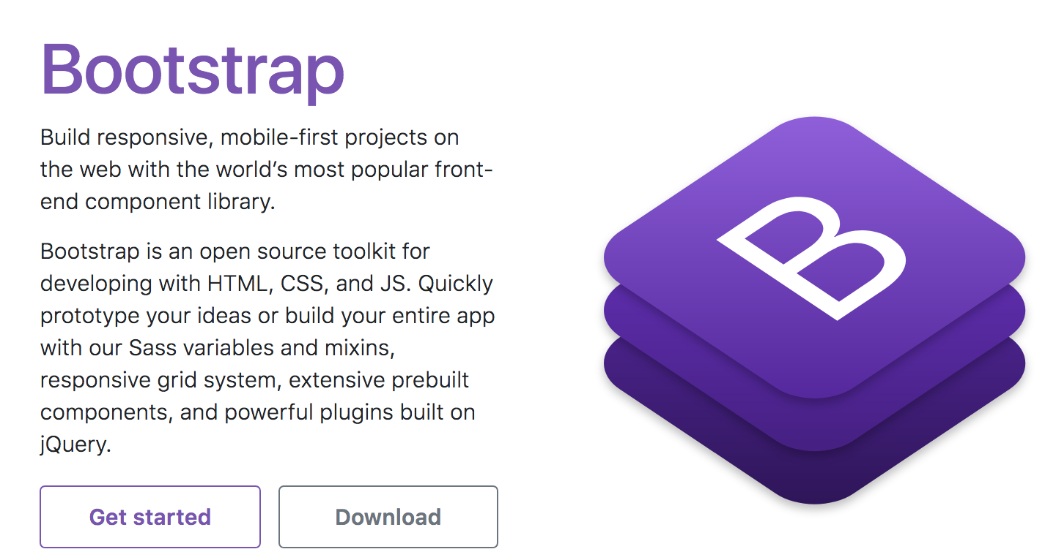
Using CSS Frameworks - Bootstrap
Go to https://getbootstrap.com/
Click Get started

Slide 27
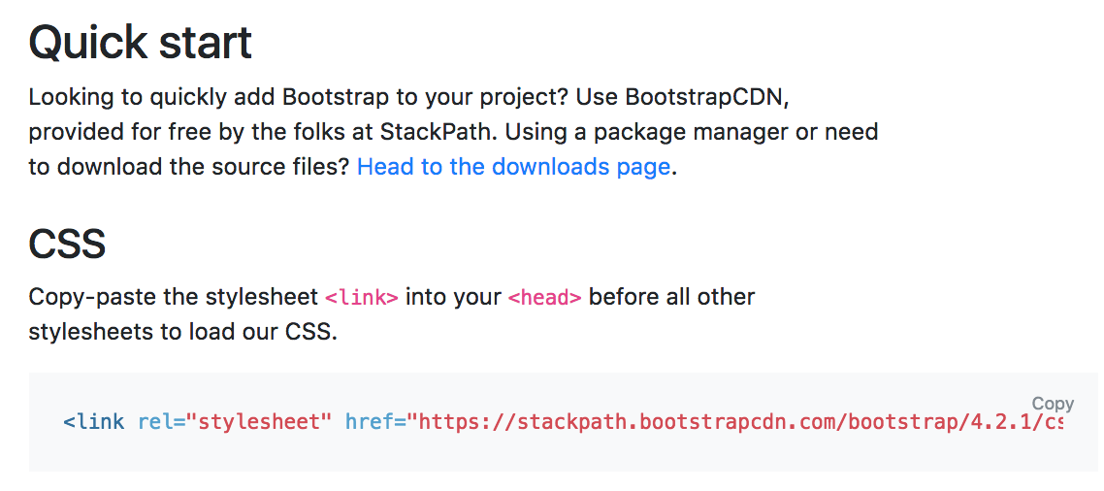
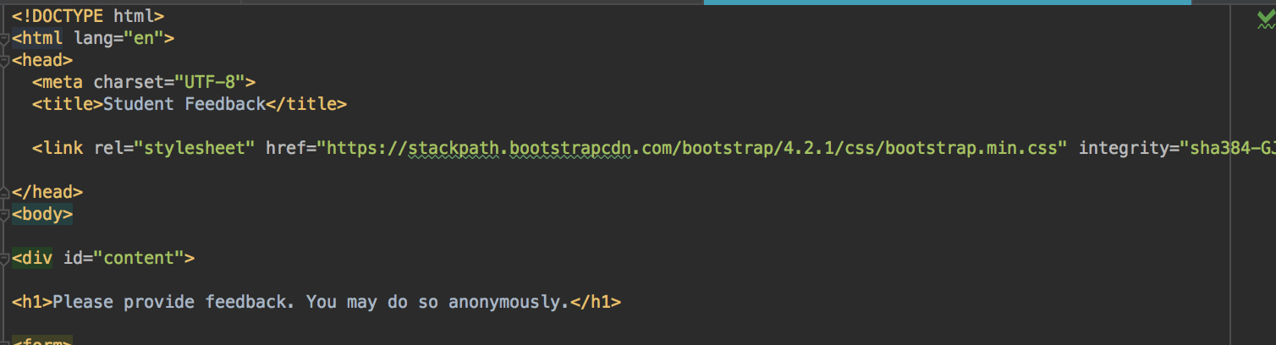
Include the Bootstrap stylesheet
Copy the CSS link into the <head> element of your page
Your version number is probably higher, that's ok

Slide 28
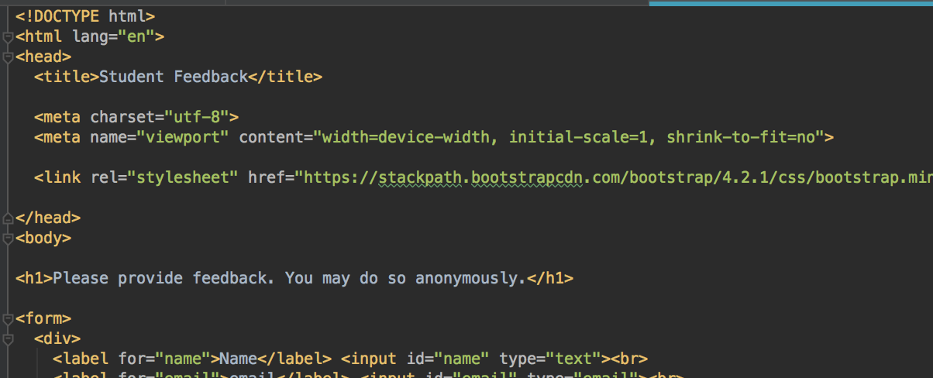
Add two meta tags
Add this to the head element
<meta charset="utf-8"> <meta name="viewport" content="width=device-width, initial-scale=1, shrink-to-fit=no">

Slide 29
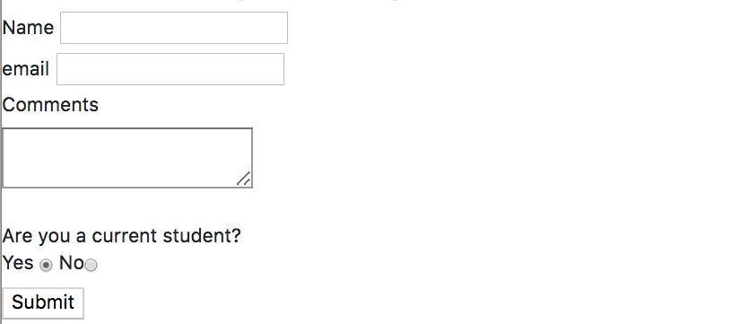
Using CSS Frameworks - Bootstrap
Page should now look something like this
Some new styles, not very different yet
No CSS
With Bootstrap

Slide 30
Bootstrap's Classes
The power of Bootstrap comes from adding classes on your elements that correspond to Bootstrap's styles

Slide 31
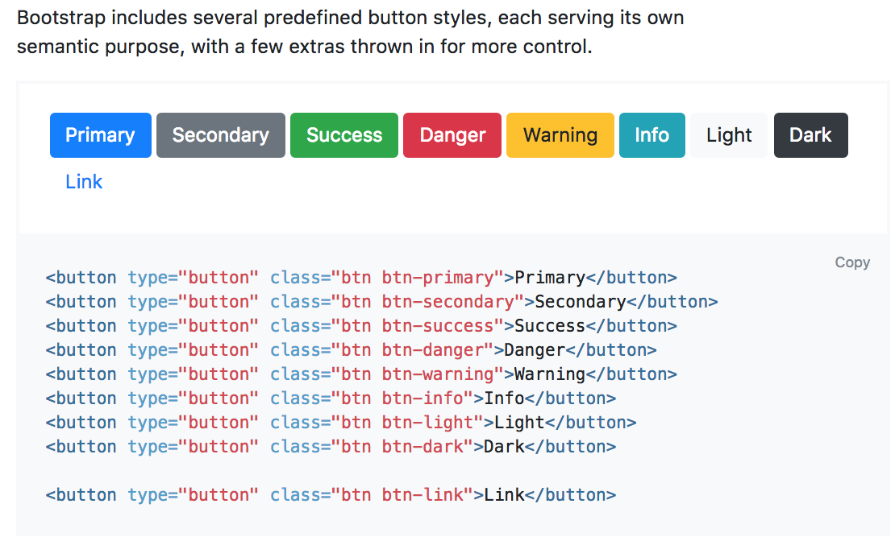
Styling Buttons
For example, you can style a submit input or a button by adding the class "btn btn-primary" or "btn btn-success" or any of the other classes

Slide 32
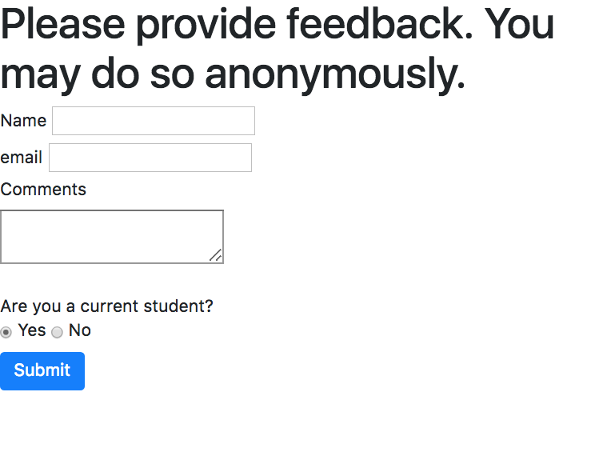
Your turn: style the button in your form
Add class="btn btn-primary" to the submit input
Bootstrap has a rule for these classes, and Bootstrap's styles are applied to your button
Bootstrap styles applied to button ->

Slide 33
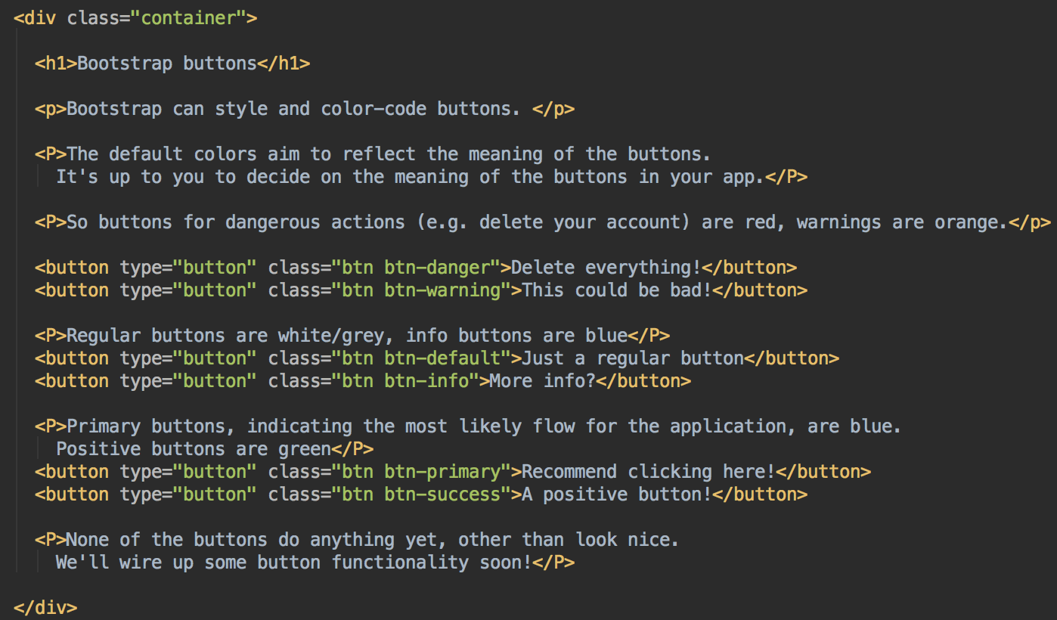
Bootstrap buttons example bootstrap-buttons.html

Slide 34
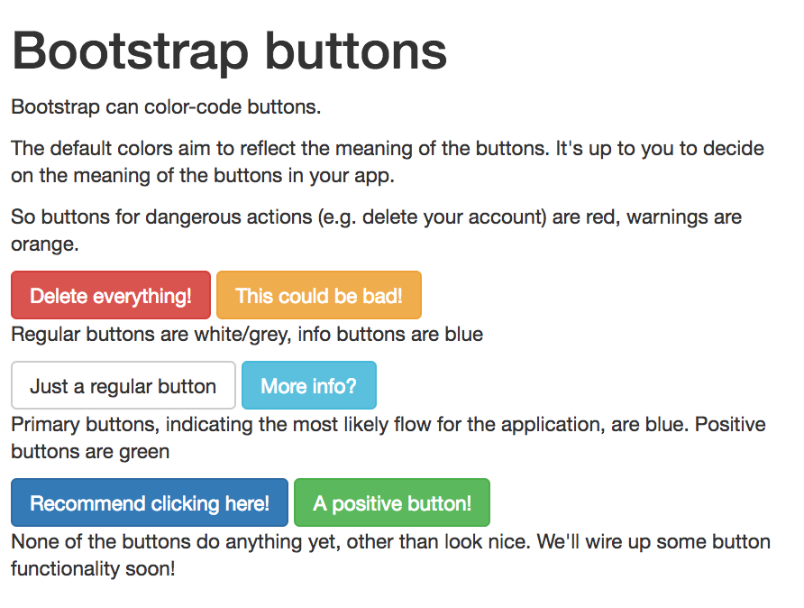
Bootstrap buttons
Style and add color to help represent the meaning of a button
It's up to you what meaning your button has. A danger button doesn't come with any dangerous functionality unless you write that code! It is simply colored red to provide a visual clue to your user.
It's up to you to add appropriate button functionality, and use the button classes to help your user navigate your app's UI.

Slide 35
Bootstrap elements
Add class attributes to the elements you want to apply Bootstrap styles/layout management to
Need to use the specific class attributes Bootstrap recognizes
Reference here: http://getbootstrap.com/css/
Note that some bootstrap components (e.g. tabs, navigation, carousels, some others) require JavaScript; examples in examples repo

Slide 36
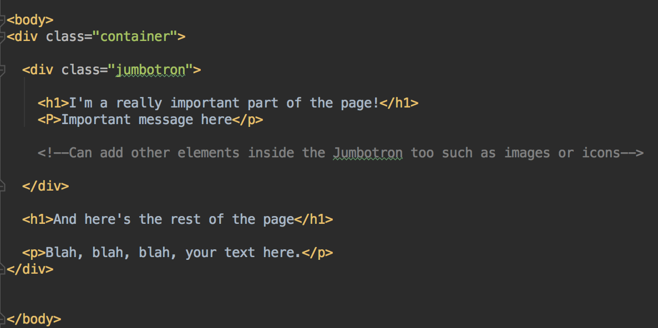
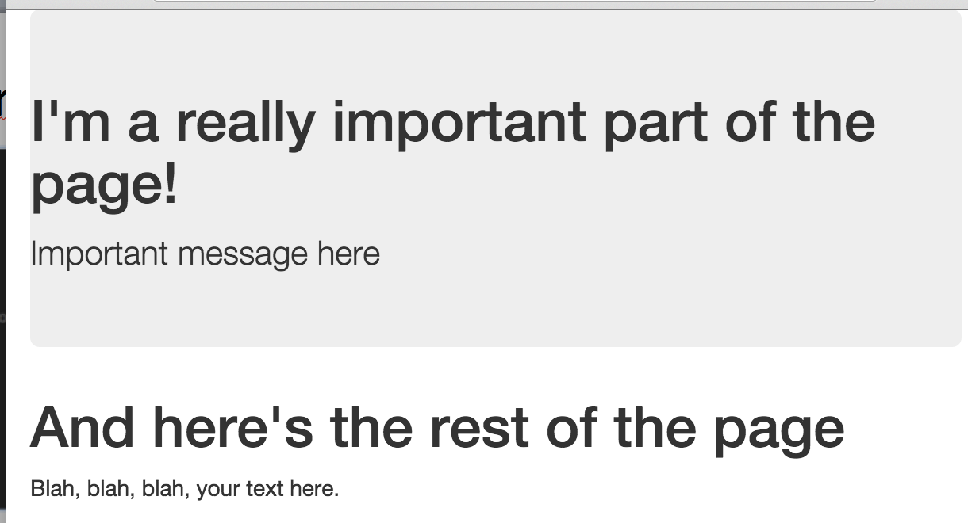
Jumbotron large wide element, used for page headers, titles, important information. Can contain other elements

Slide 37
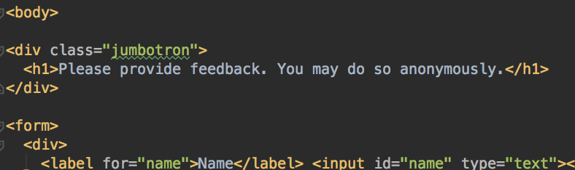
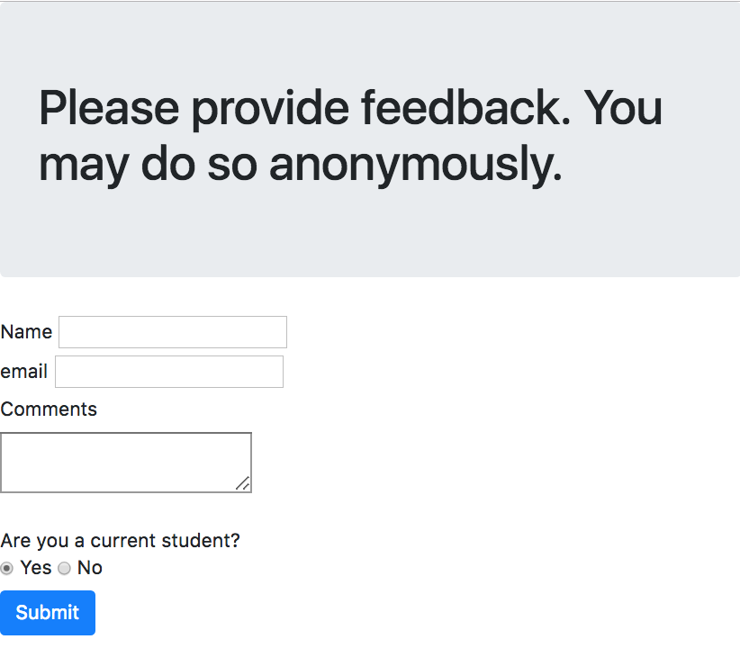
Add a jumbotron to your page
Add a div with class="jumbotron"
Put some header text in the jumbotron div

Slide 38
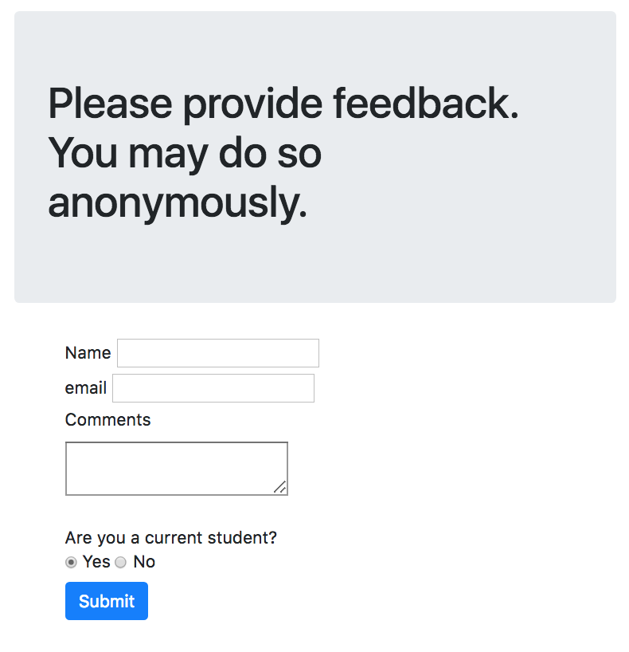
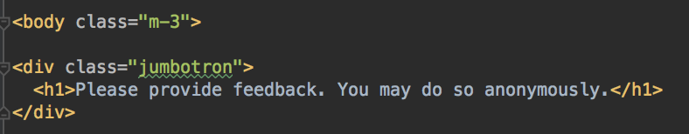
Margins and padding
Add the class "m-3" to your page body to apply a margin to the body
m-1, m-2, m-3, m-4, m-5 for different sized margins
Can apply to certain sides, for example
mt-3 adds margin 3 to the top
ml-2 adds margin 2 to the left
Add class="ml-5" to your form
Entire page, margin 3
form left margin 5

Slide 39
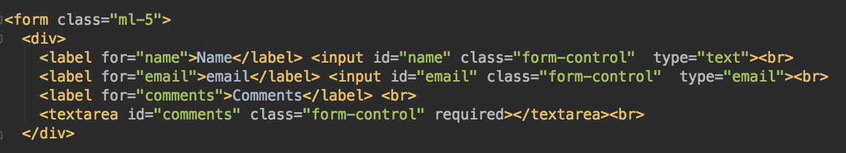
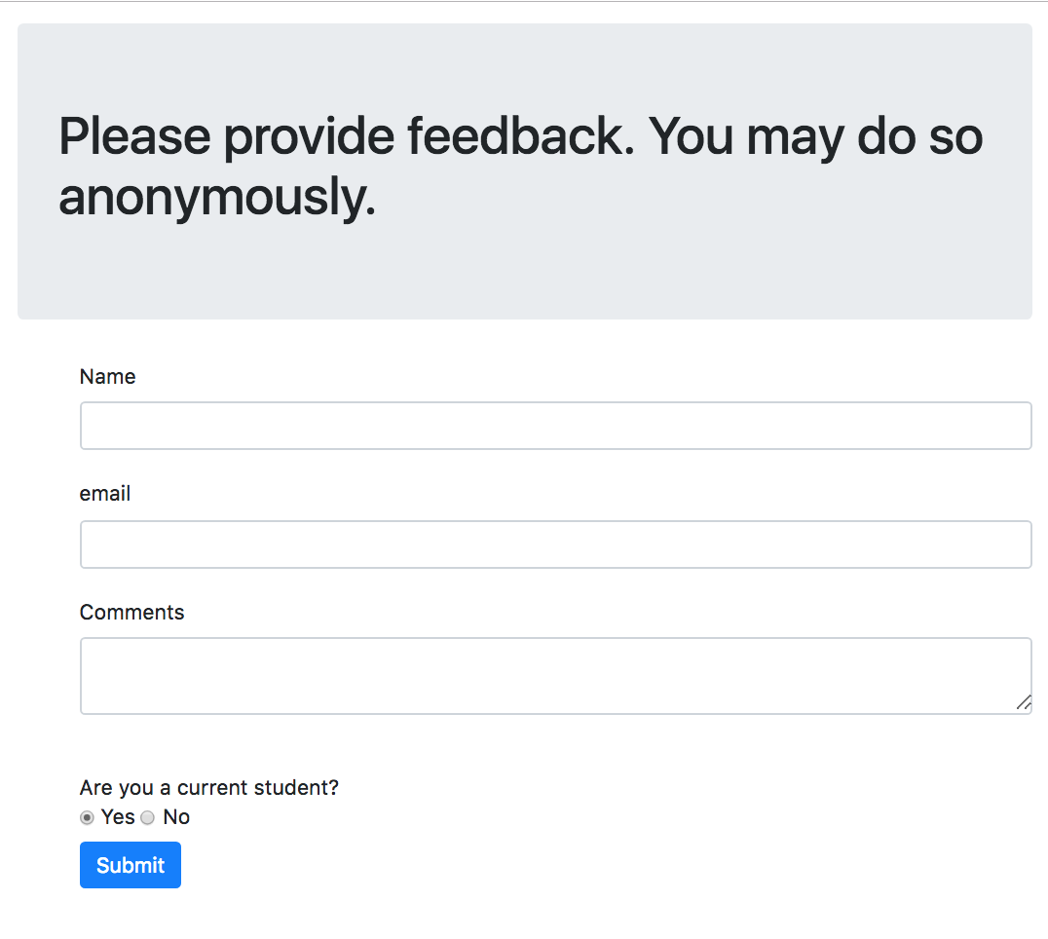
Style inputs
Add the class="form-control" to your input text and text area

Slide 40
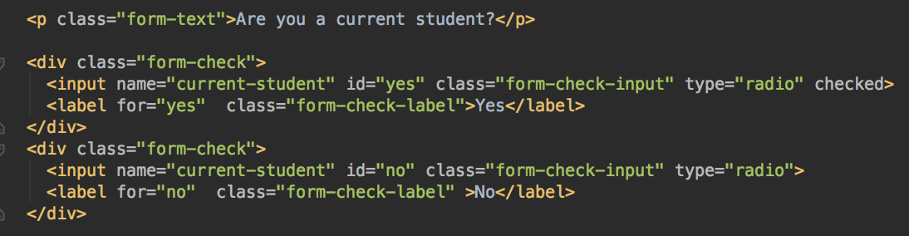
Style radio buttons
A little more work
Each radio button & input needs to be in a div with class="form-check"
Give the radio button input the class="form-check-input"
Give the label the class="form-check-label"

Slide 41
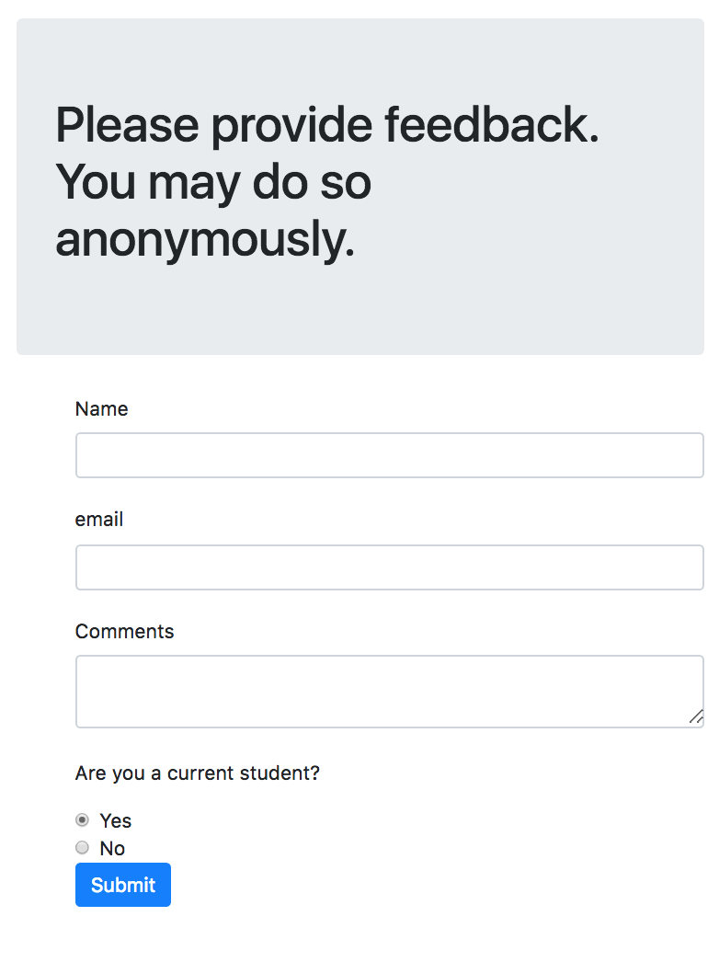
Styled radio buttons

Slide 42
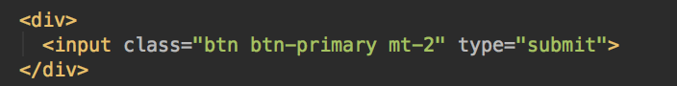

A top margin for the submit button
Add class="mt-2" to the submit button
Notice this elements already has some classes
You can add as many classes to an element as you want, separated with spaces

Slide 43

Adding your own styles
For example, we might like to change the color of the jumbotron, or use a different font
Create a new stylesheet called feedback-styles.css
Add a link to your stylesheet in the head of your page, after the bootstrap link
This means the bootstrap styles will be applied first, and then your styles - so yours can override Bootstrap if needed

Slide 44

Reminder: CSS works like before
Example of applying a style for every element of a certain type

Slide 45

Reminder: CSS Classes
Add a class attribute to one or more elements
use .classname in CSS to apply styles to elements with that class
Example: make elements with class="skill" grey

Slide 46


CSS: Change Jumbotron Color
In feedback-styles.css, change the Jumbotron to the color of your choice
For example,

Slide 47
CSS: Fonts and Typography
Browsers have a set of built-in fonts, can set in CSS
But, not all browsers have all the same fonts, so your page may look a little different between browsers
Various libraries of fonts available online, for more consistent appearance
Google Fonts https://fonts.google.com/
Font Awesome https://fontawesome.com/

Slide 48


Adding Fonts
In CSS, using a browser font, set font-family
Good practice to include a list of fonts, if the first font is not found, the browser will try the rest of the fonts in turn
All browsers know monospace, serif, san-serif

Slide 49

Adding Fonts from a Library
Add a link to the font library's CSS, or to the specific font, in your page head
Styles will be available to your page

Slide 50


Example - Coiny from Google Fonts
Step 1: look up the font library CSS, and include a link to the font library CSS
Step 2: Use the font family in your CSS

Slide 51

Your Turn
Go to Google Fonts
https://fonts.google.com/
Choose a font you like
Get the link for that font
Click the red + button to get the link for the font
Challenge: pick two or more fonts, add links to both/all, and style different parts of your page with different fonts

Slide 52

Your Turn: adding a font to the student feedback page
Add the Google Fonts CSS link to the head of your page

Slide 53


Your Turn: apply font-family styles in feedback-style.css
For example, style the body (all the text)

Slide 54


Your Turn - Add Another Font
Use a different Google font for the text in the Jumbotron
Select another Google font, add it to your page, and style the Jumbotron
Some font style tips: pick fonts that contrast for better visual effect; avoid using too many different fonts within a page
https://uxplanet.org/7-things-to-remember-when-selecting-fonts-for-your-design-ec1e592266c5

Slide 55

Web Colors
You can use one of the ~150 HTML color names that all browsers should understand
e.g. Red, Green, Yellow, DarkMagenta, LightSkyBlue…. full list here: https://www.w3schools.com/colors/colors_names.asp
Or, you can use a hexadecimal (hex) number to describe your exact color
All colors can be made of a combination of red, green, and blue light
Specify how much red, green, blue should be mixed together to produce the color desired
A hex color code is six hexadecimal digits; two each for the amount of red, green, blue
In CSS, preface a hex code with a # symbol
red green blue
Hex is base 16, and uses the characters 0-9 plus A, B, C, D, E, F as digits.
6 hex digits = 32 bytes = 16.7 million possible colors.

Slide 56


Finding Hexadecimal Colors
Hexadecimal color picker from Google
https://www.google.com/search?q=hex+color+picker
Sites like http://paletton.com/ for creating color schemes
http://colormind.io/ generated colors

Slide 57


Your Turn
Change the background color of your page to the color of your choice
Use a hex color picker to select a hex color
Add the style to the feedback-styles.css stylesheet
Example (but use your hex color)

Slide 58
Bootstrap Responsive Design
Attempt to organize the same components in different ways, appropriate for different screen widths
So a mobile browser will display the same components as a desktop browser, but arranged differently
The desktop browser may have enough room to display the components in a horizontal row
But the mobile app has less screen size so will stack the same components vertically

Slide 59
Rows and Columns
Bootstrap can treat your page as a grid of rows and up to 12 columns
A row contains columns, arranged horizontally
Each column is at least 1 unit wide
A column can span more than one column unit
Columns (and elements each contains) are arranged based on your screen size
To use columns:
Create a row
Add columns to the row,
specifying the width of each column (in column units)
specify the screen width at which that column should start stacking, instead of being in a horizontal row
Create more rows (and the columns within) as needed

Slide 60

Columns and Resizing
Grid system

Slide 61

bootstrap-columns.html
Define a row
Columns
Organize page into logical rows
Within rows, break into desired number of columns
Each column should specify the screen size, at or below which, at which it should stack
And, it must specify that column's width, in column units that it spans. There are 12 units per row
Define a column
Define another column

Slide 62


Wide screen, columns displayed in same row
Narrow screen, columns stack
bootstrap-columns.html

Slide 63

Columns
Specify rows
Inside each row, specify your columns
Inside each column, add the elements it will contain
boostrap-more-columns-with-styles.html

Slide 64

Column Classes
Column classes take the form col-stacksize-span
stacksize can be xs; sm; md; or lg. These are screen resolutions – at this screen resolution and above, the columns will be displayed in a horizontal row. Below the specified screen resolution, the columns will stack. It's up to you to make sure your components do fit
Figure out how wide each component is and how much room it needs so you can provide enough column units for it to fit and not overlap with the other columns
span is the number of units the column spans e.g. col-sm-6 or col-md-2
Span for all the columns in a row must add up to 12
stacksize | example device | width
xs | Phones | -
sm | Tablets | 768px
md | Desktops | 9992px
lg | Large screens | 1200px

Slide 65


Columns don't need to be same width Use wider columns for wider components bootstrap-non-equal-width-columns.html

Slide 66


Your Turn
Add div class="row" and div class="col" to display instructions and form, in columns
Next slide ->

Slide 67


Slide 68
Your Turn
Verify the instructions are on the left of the form
Make your browser window wider and narrower, and verify the columns stack when the window is narrow, and unstack when it is wide
The margins may not look good now, so adjust the paddings and margins so the page looks good with the columns stacked, and when they are not stacked

Slide 69
Lab 2
In D2L
Please ask if you have any questions
Please let me know if anything isn't clear
Please ask if you need help
The best students ask lots of questions!

